Slide 1
Atomic physics
Instructor:
Kaifeng Zhao (赵凯锋)
zhaokf@fudan.edu.cn,
18019208940 (Wechat)
Office: building 1, room 215
nuclear science and technology dept.

Slide 2
Study efficiently
Flipped classroom
Lecture notes and assignments centered
Pay attention to new concepts and methods
Use a pen and a notebook during the lecture
Discussion
Homework
  submit on time
  write your reasoning process, especially where you got stuck.
Notes:
抽象：质点，刚体
涉及：弹力，摩擦力

Slide 3
The Feynman Lecture on Physics
“If, in some cataclysm, all of scientific knowledge were to be destroyed, and only one sentence passed on to the next generations of creatures, what statement would contain the most information in the fewest words?”
“I believe it is the atomic hypothesis that all things are made of atoms — little particles that move around in perpetual motion, attracting each other when they are a little distance apart, but repelling upon being squeezed into one another.”

Slide 4
Branches of Science heavily reply on atomic physics
Astrophysics
plasma physics
atmospheric physics
solid state physics
chemical physics
radiation physics
Chemistry (analysis, reaction rates)
biology (molecular structure, physiology)
materials science
energy research
fusion studies

Slide 5
Modern atomic physics - Atomic, Molecular and Optical (AMO ) Physics
Precision measurement
  Testing the fundamental laws of physics
  atomic clock, optical clock, nuclear clock
Quantum sensing
  Atomic magnetometer(磁力仪), atomic gyroscope (陀螺仪), atomic gravimeter (重力仪)
  Magnetic Resonance Imaging (MRI) 核磁共振成像
  Electromagnetic Induction Imaging (EMI) 电磁感应成像
Cold atoms and ions, optical lattices
Quantum information, computation and communication
Ultra-intense and ultrafast lasers
We don’t do atomic bombs, which should be called nuclear bombs.
We study the electromagnetic interactions between electrons, nucleus and external EM fields

Slide 6
Syllabus
The birth of atomic physics and quantum mechanics
elements of quantum mechanics
Atomic structure and interaction with EM fields
Advances in modern Advances

Slide 7
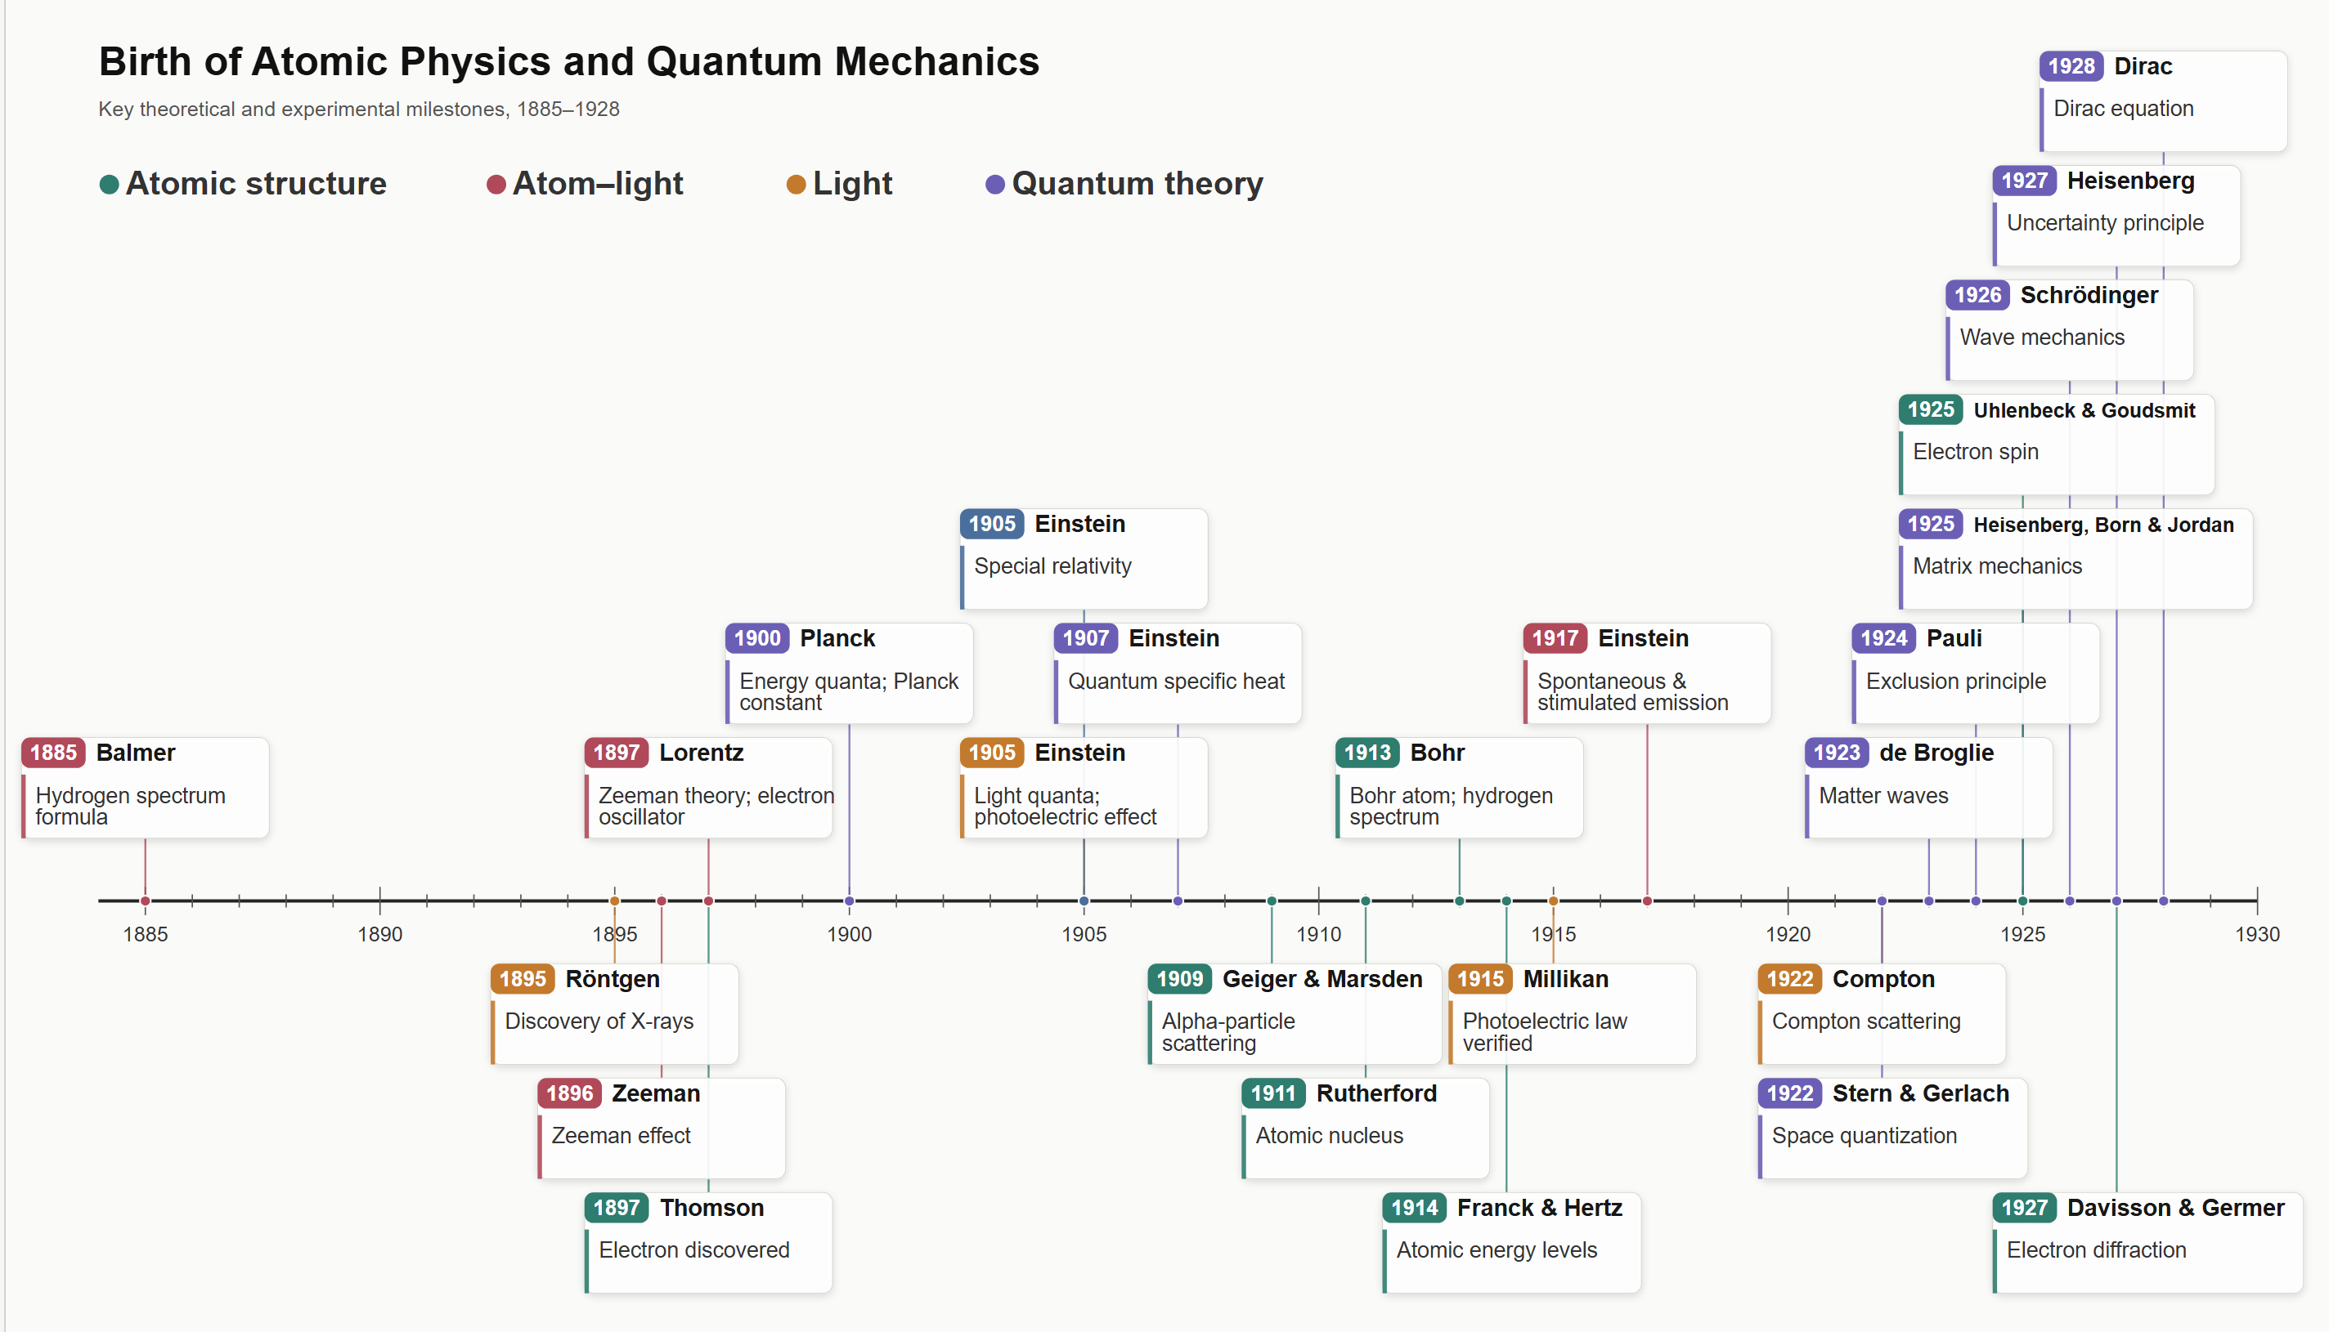
Notes:
http://faculty.wcas.northwestern.edu/~infocom/Ideas/quantum_timeline.html

